Slide 1


FROM EXCEL TO
R

Slide 2





SUND DATA LAB
WHO ARE WE?
Center for Health Data Science (HeaDS):
Data Science Research Groups
HDS Sandbox (Infrastructure Project)
SUND Data Lab
https://heads.ku.dk/
Thilde Terkelsen
Helene Wegener
SUND Data Lab:
Courses & Workshops, Seminars, etc.
Health Data Science Consultations
Commissioned Research & Supervision
Hub for Data Science (Matchmaking)
Chelsea Lennox
Tugce Karaderi
Data Science Laboratory (DSL) - https://datalab.science.ku.dk/
2
Notes:
First time running this course. There will be an evaluation, please be patient with us, we are not quite sure how this will go :-)

Slide 3
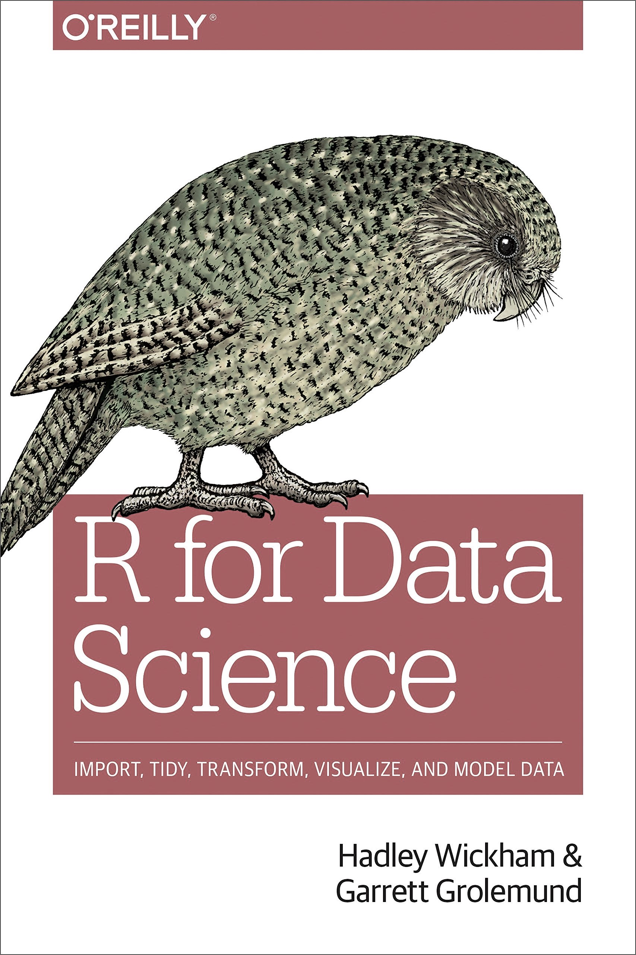
FROM EXCEL TO R
THE PRACTICALS
Two days: 9.00-16.00. There will be coffee breaks, we promise
“R for Data Science” - a generally useful book on R, also for this course
The course is build on hands-on presentations & exercises
Download and install the newest version of R (https://cran.r-project.org/)
Download and install the newest version of R-studio (https://posit.co/download/rstudio-desktop/)
Go to course website: https://center-for-health-data-science.github.io/FromExceltoR/
3

Slide 4

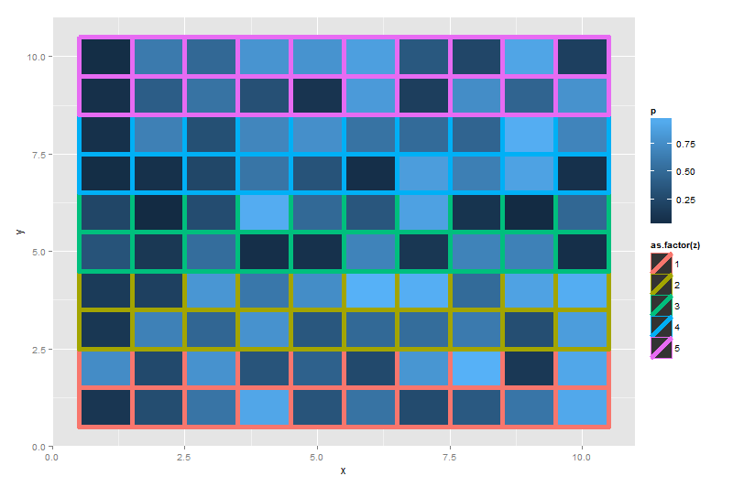
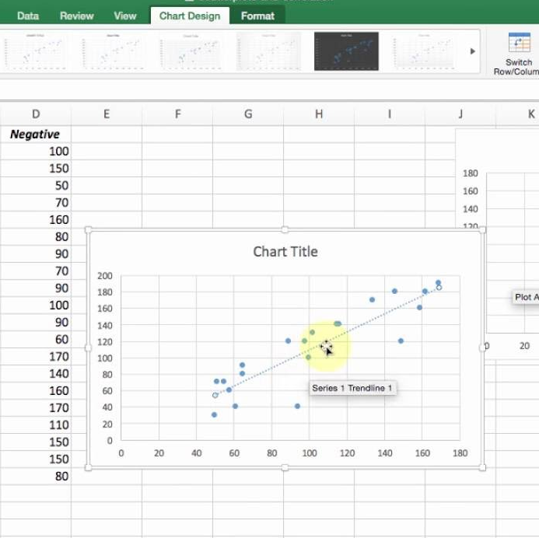
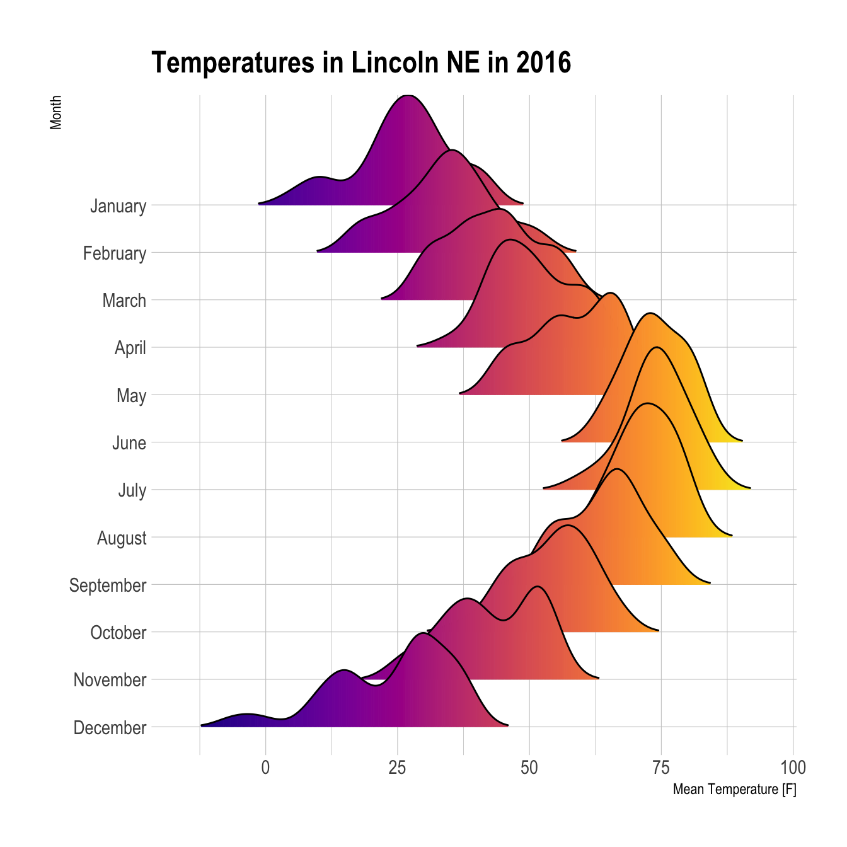
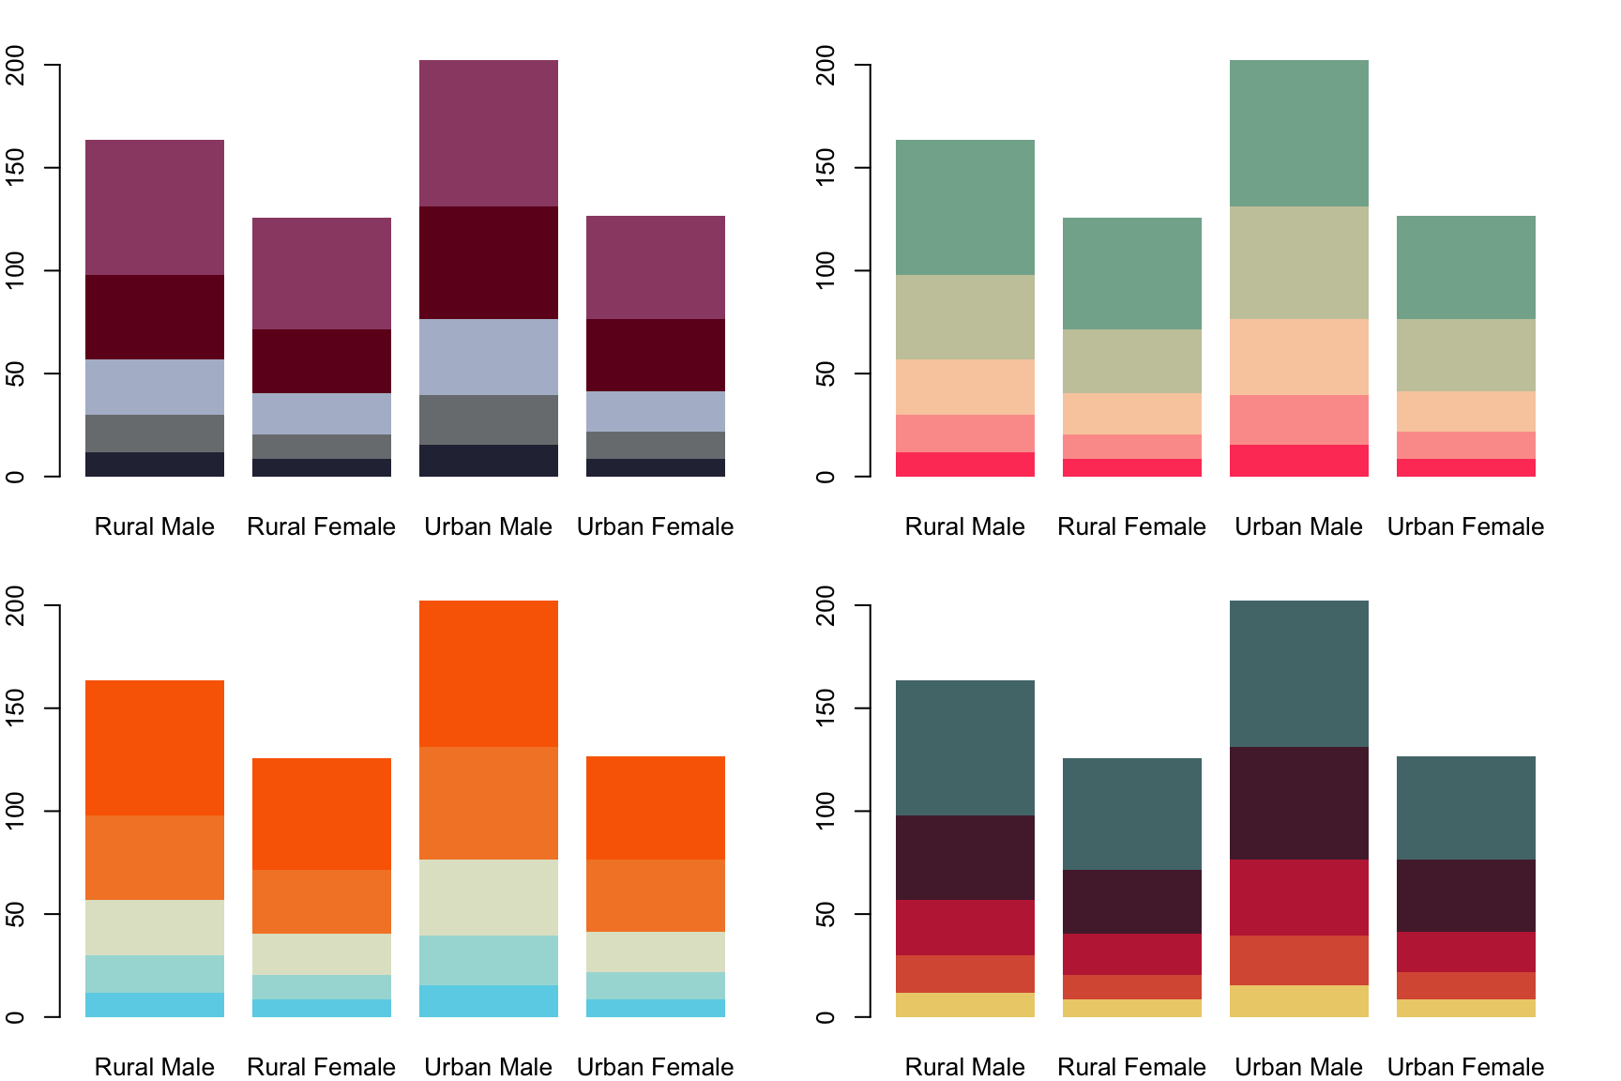
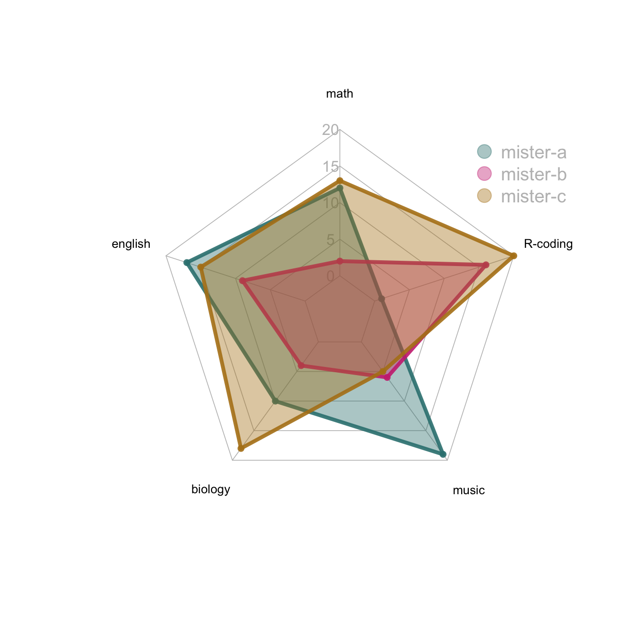
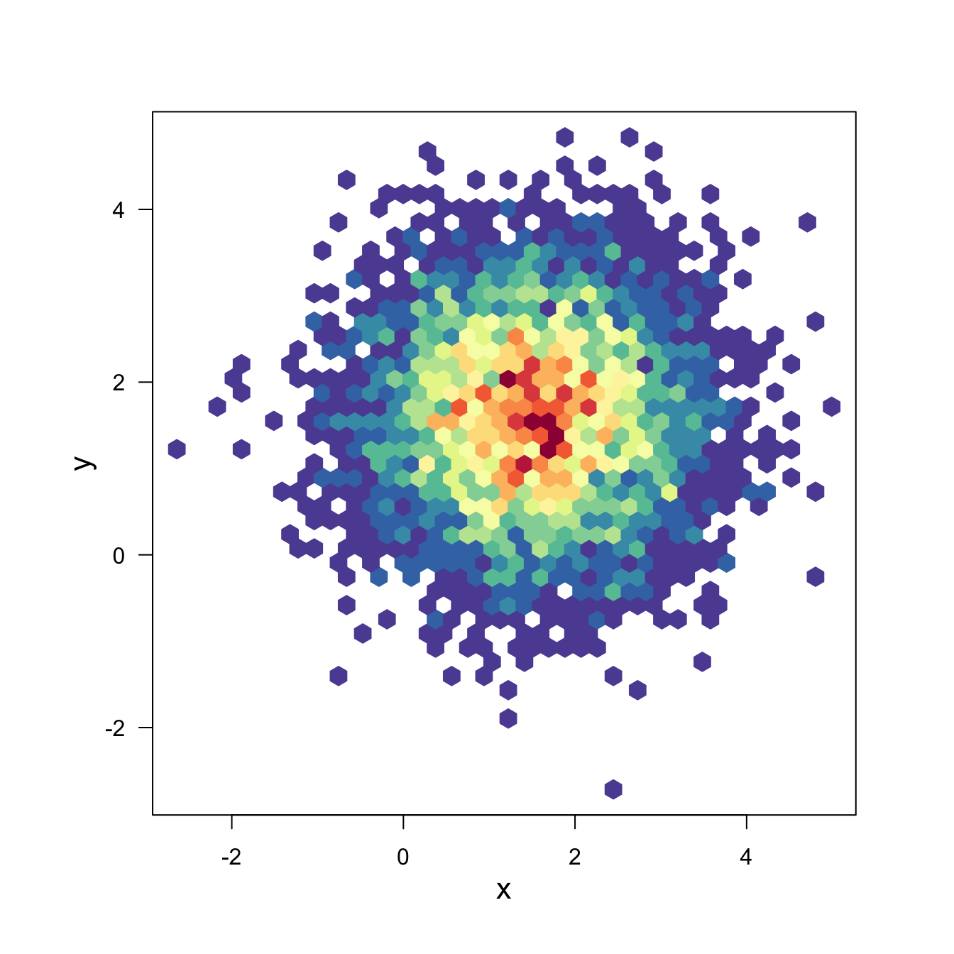
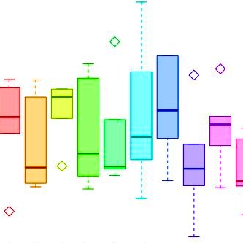
WELCOME TO
FROM EXCEL TO R
R
4
Notes:
[Talk shortly about why here. Open source, easy and intuative for data wrangling and plotting which are the first steps you will need to do to your data]

Slide 5

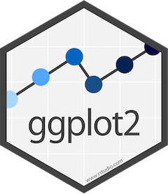
FROM EXCEL TO R
WHAT WILL I LEARN?
DATA WRANGLING
PLOTTING
tidyverse
Data Structures
Useful Functions
Pipe (“clean” code)
ggplot2
Code structure
ggplot2 + tidy data
THE BASICS
STATISTICS
R
RStudio
Scripts, paths, files
R project
Help recourses
Linear models
ANOVA
Post Hoc Tests
5
Notes:
[Copy of previous slide but with potential update]

Slide 6
FROM EXCEL TO R
PROGRAM
DAY 1
DAY 2
08:30 - Installation Issues + Coffee
09:00 - Introduction to R Basics
10:00 - Rstudio Exercise
10:45 - Break
11:00 - Tidyverse
12:00 - Lunch
13:00 - Tidyverse Exercise
14:30 - Break
14:45 - ggplot2
15:15 - ggplot2 Exercise
16:00 - See you tomorrow
08:30 - Coffee + Optional Q&A
09:00 - Applied Statistics
10:00 - Applied Statistics
10:45 - Break
11:00 - Applied Statistics
12:00 - Lunch
13:00 - Data Analysis Exercise
14:30 - Break
14:45 - Data Analysis Exercise
15:45 - Cool things in R + Course Evaluation
16:00 - Bye Bye Bye!
6
Notes:
Possibility to bring your own data.

Slide 7
FROM EXCEL TO R
LET’S GET STARTED
R

Slide 8
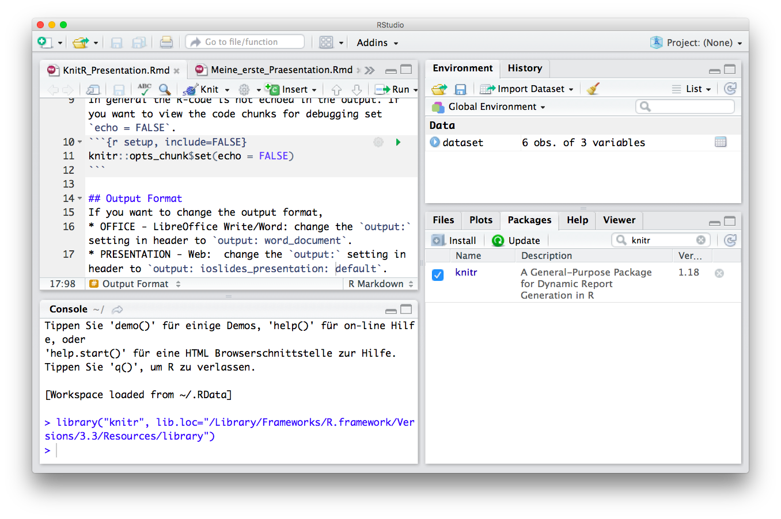


FROM EXCEL TO R
R & FRIENDS
R
R
Studio
Scripting / Programming Language
Objects in Environment
R-scripts (Save Your Code)
Console (Run and Test Code)
Overview by Type, Help and R-packages
Reports (html, pdf, word)
R Code Interpreter and Editor
8
Notes:
Markdown is a plain text language with formatting syntax designed so that it can be converted to HTML and many other formats.
They are written using an extension of markdown syntax that enables R code to be embedded in them in a way which can later be executed.
Knitr takes a plain text document with embedded code, executes the code and 'knits' the results back into the document.

Slide 9

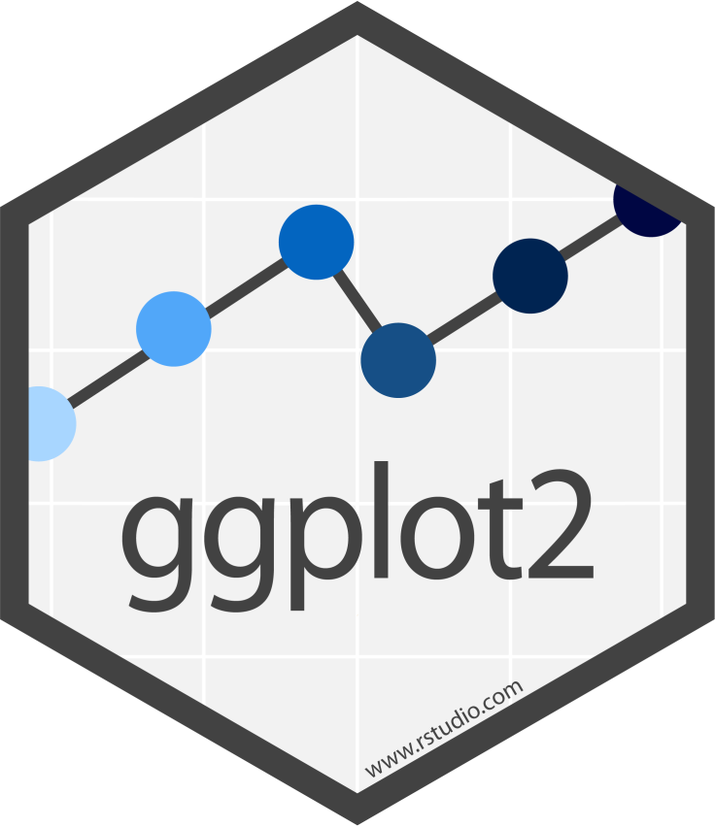



FROM EXCEL TO R
THE ANATOMY OF R
R
R
Studio
The programming language may be used from within in the Code Editor
.R
.Rmd
.qmd
The R code you write may be saved in scripts with extensions:
select()
mutate()
mean(x)
sd(x)
Functions perform actions based on input arguments and return an output:
Packages are bundles/libraries of functions.
tibble()
9
Notes:
A double is a double-precision, 64-bit floating-point data type. It accommodates 15 to 16 digits, with a range of approximately 5.0 × 10−345 to 1.7 × 10308

Slide 10

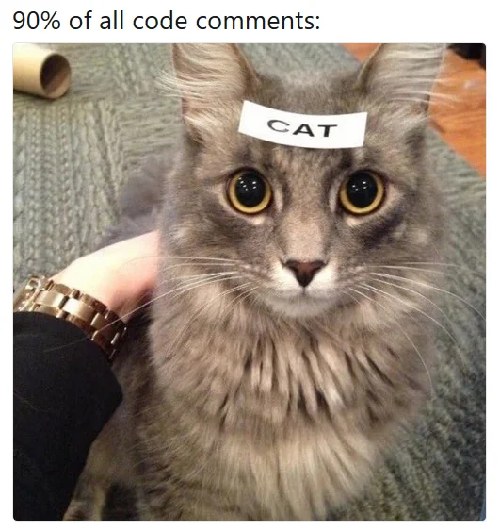
https://www.quarto.org/
QUARTO DOCUMENTS
Tool which supports reproducible coding/publication (reports)
Quarto works with a markup language
A markup language is text-coding system which specifies structure & format of a document and the text within it
We render (compile) a Quarto → html, pdf, word, website
Pointers for quarto:
Seperate sections with headers
Do not overfill code chunks
Write meaningful and precise comments
10
Notes:
dpyr functions are like lego. You can add them however you want (in theory).

Slide 11
https://www.quarto.org/
PATHS – LOCATION, LOCATION, LOCATION
The directories on your computer are organized in a File Tree
Move between directories or point to a place in the tree with a specific file
abc123
We do this by specifying a path:
Move to: /abc123/Documents/Research
Point to: /abc123/Documents/Research/myData.csv
Data
Documents
Desktop
The place you are, right now, is called the working directory (wd)
Where am I: getwd()
Go to : setwd(‘path’)
Exp1.csv
Teaching
Research
myData.csv
11
Notes:
dpyr functions are like lego. You can add them however you want (in theory).

Slide 12

FROM EXCEL TO R
LIVE CODING 1 – INTRO TO R

Slide 13

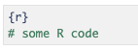
https://quarto.org
QUATO CHEAT SHEET
YAML parameter:
Code Chunk:
---
title: My Project Name
output:
html_document (pdf_document, …)
---
Source mode:
```{r}
# some R code
```
Visual mode:
GETTING
STARTED
Code Options:
Figure Options:
{r echo = FALSE} # don’t print code (default is TRUE)
{r eval = FALSE} # don’t run code (default is TRUE)
{r error = FALSE} # don’t display error message (default is TRUE)
(Can also be set for warning and message)
fig.align (='left', 'right', 'center')
fig.cap (= 'my figure cation’)
fig.height (= n), fig.width (= n)
CHUNK OPTIONS
Source mode:
Header
Text
Lists
List item1 (filled dot)
+ sub-item1 (open dot)
List item1 (numbered)
i) sub-item1 (roman)
*italics*
**bold**
`highlighted`
TEXT
Header size ranging from largest (one #) to smallest (six #):
# my.text, ## my.text, ### my.text, etc.
13

Slide 14
DATA STRUCTURES
DATA TYPES
Vector
Numeric
Age
-1.5, 2.7, 3.2
Data Frame
FROM EXCEL TO R
Age
Height
BMI
Integer
R DATA TYPES & STRUCTURES
-2, -1, 0, 3, 5
List
Character
“A”, “Bat”, “Tom”
VARIABLES
Array
Factor
G1, G1, G2, G3
OBSERVATIONS
Tibble
Logical
< >
< >
< >
< >
< >
TRUE, FALSE
12
Notes:
A double is a double-precision, 64-bit floating-point data type. It accommodates 15 to 16 digits, with a range of approximately 5.0 × 10−345 to 1.7 × 10308

Slide 15
https://www.rstudio.com/wp-content/uploads/2016/10/r-cheat-sheet-3.pdf
INTRO CHEAT SHEET
Basics:
Read in Data:
getwd() # location
install.packages("package_name") # install packages
library(package_name) # load packages
read.xlsx("name.xlsx”) # library(readxl)
read.delim("name.txt", sep ="\t") read.csv("name.csv", sep=";")
GETTING
STARTED
Overview:
view() # view data as table
df$col1 # extract column from dataframe
nrow(df), ncol(df) # number of rows/columns
head(df, n=10), tail(df, n=10) # first or last 10 rows
unique(), table(), count() # unique vals, count vals
OVERVIEW
CHUNK OPTIONS
Type/Class:
Conditions:
class() # get data type/class
is.numeric(x), is.character(), is.factor() # is data type
as.numeric(x), as.character(), as.factor() # change data type
a > b a < b
DATA TYPES & CONDITIONS
a == b a != b
a >= b a <= b
is.na() is.null()
Summary Stats:
Plots:
summary() # summary statistics
mean(), median(), sd(), sum(), log(), max(), min(), quantile(), var()
plot(x)
plot(x, y) or plot(col1, col2, df) # scatter
hist(x) # histogram
STATISTICS &
BASE PLOTS
14

Slide 16
FROM EXCEL TO R
ONLINE RESOURCES FOR R
https://www.r-project.org/
GET STARTED
GRAPHICS
BOOKS & COURSES
OTHER RESOURCES
https://www.r-bloggers.com/best-books-to-learn-r-programming/
https://www.datacamp.com/
https://www.codecademy.com/
https://www.coursera.org/
https://github.com/trending/r
https://blog.revolutionanalytics.com/
https://stackoverflow.com/questions/tagged/r
https://rseek.org/
https://rstudio.com/resources/cheatsheets/
http://www.cookbook-r.com/
https://www.statmethods.net/r-tutorial/index.html
https://www.r-graph-gallery.com/
http://r-statistics.co/Top50-Ggplot2-Visualizations-MasterList-R-Code.html
15

Slide 17
1
2
R project & R Script
Read & Write
Basic calculus
Base plot
R help
Save & Shutdown
3
FUNDAMENTALS
R
Studio
EXERCISE 1
4
5
16

Slide 18
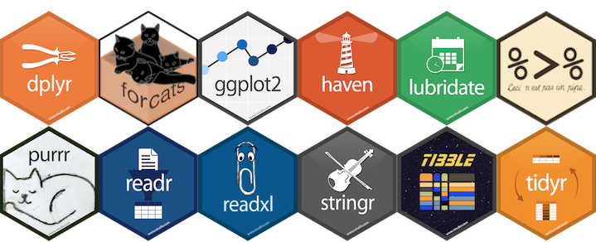
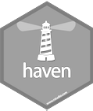

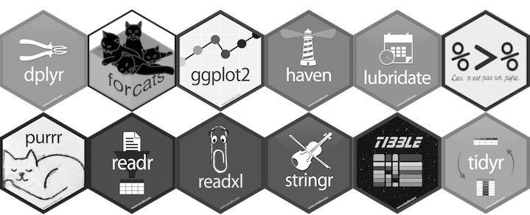
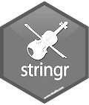
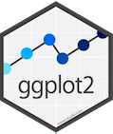
tidyverse is a collection of R packages for data science
READING DATA
“The packages share an underlying design philosophy, grammar, and data structures.” Wickham and Grolemund
TIDYING
https://www.tidyverse.org/
TIDYVERSE
MANIPULATION
tidyverse is used to “tidy up” your datasets, so they are easy to work with
PROGRAMMING
VISUALIZATION
17

Slide 19
https://www.tidyverse.org/
CECI N'EST PAS UNE PIPE
%>%
tidyverse
You do NOT have to “chose” between
tidyverse and base R
base R
base R
# think from the inside out
g(f(x,y),z)
BENEFITS
?
CONSIDERATIONSS
tidyverse
Short & well-organised code
Can be less stable
# no brain acrobatics
x %>% f(y) %>% g(z)
Tidy datasets, easy to work with
“Different syntax”
Great documentation
pipe symbol
Functions with logical names & inputs
Remember what tidyverse is made for!
18
Notes:
dpyr functions are like lego. You can add them however you want (in theory).

Slide 20

FROM EXCEL TO R
LIVE CODING 2 – TIDYVERSE

Slide 21
https://www.tidyverse.org/
TIDYVERSE CHEAT SHEET
readr, tidyr, dplyr, …
Read Data (readr)
Workflow
Data Manipulation (dplyr)
Reading tabular data
There are solutions for multiple data types
read_excel() # using readxl package
read_table()
read_csv()
Useful arguments
Skip lines: read_csv(file, skip=1)
Read subset: read_csv(file, n_max=1)
Data types
readr guesses the types of each column and tells you about it
(“Parsed with column specifications: …”)
Tidyverse workflow
df %>%
select(col1)
df %>%
filter(col1 < x)
df %>%
summarize(n_1 = n(),
avg_1 = mean(co1),
sd_1 = sd(col1))
Select column
df$col1
Summary
summarize()
count()
Group
group_by()
Functions will manipulate each group separately and combine results.
Extract and sort observations (rows)
filter() # subset rows by condition
distinct() # subset to unique values
top_n() # subset by position
arrange() # sort low->high, other way with desc()
Manipulate variables (columns)
select() # subset rows by condition
mutate(new_name = f(column))
mutate(new_name = ifelse(col1 < x, ”Yes”, ”No”))
mutate(new_name = col1 + col2)
HELP
R Documentation (e.g. enter ?dplyr::filter and see examples)
Much more info and detailed cheat sheets:
https://brianward1428.medium.com/introduction-to-tidyverse-7b3dbf2337d5
It also helps to google “tidyverse + whatever_you_want_to_do”
20

Slide 22
1
2
TIDYVERSE
R
Studio
3
EXERCISE 2
4
Tidyverse:
Filtering
Selecting
Mutating
Arranging
Summarizing
5
21

Slide 23
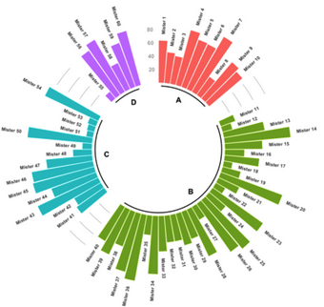
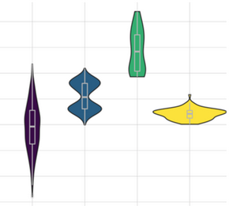
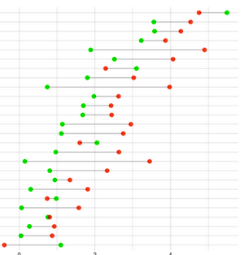
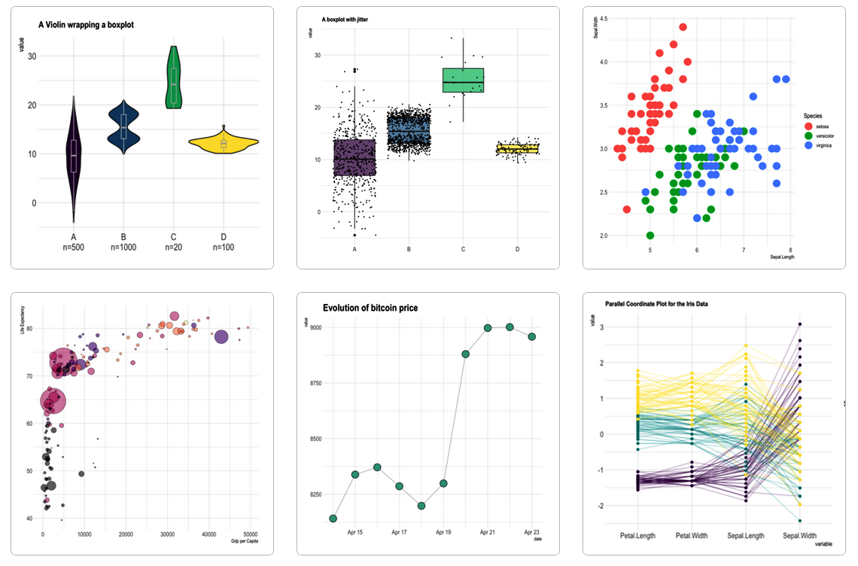

https://www.r-graph-gallery.com/
GGPLOT2 - EASY GRAPHICS
Aesthetically pleasing graphics.
Well-defined “additive” (+) structure.
Integrates perfectly with tidy data.
Great documentation & community
22
Notes:
Plots to visualize data
Additive structure: Build a plot layer by layer where each layer enhances the plot. This makes plots easily customizable.
Tidydata: One row per observation, one variable per feature.
ChatGPT

Slide 24
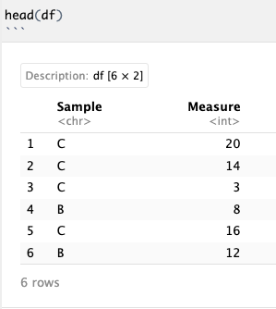
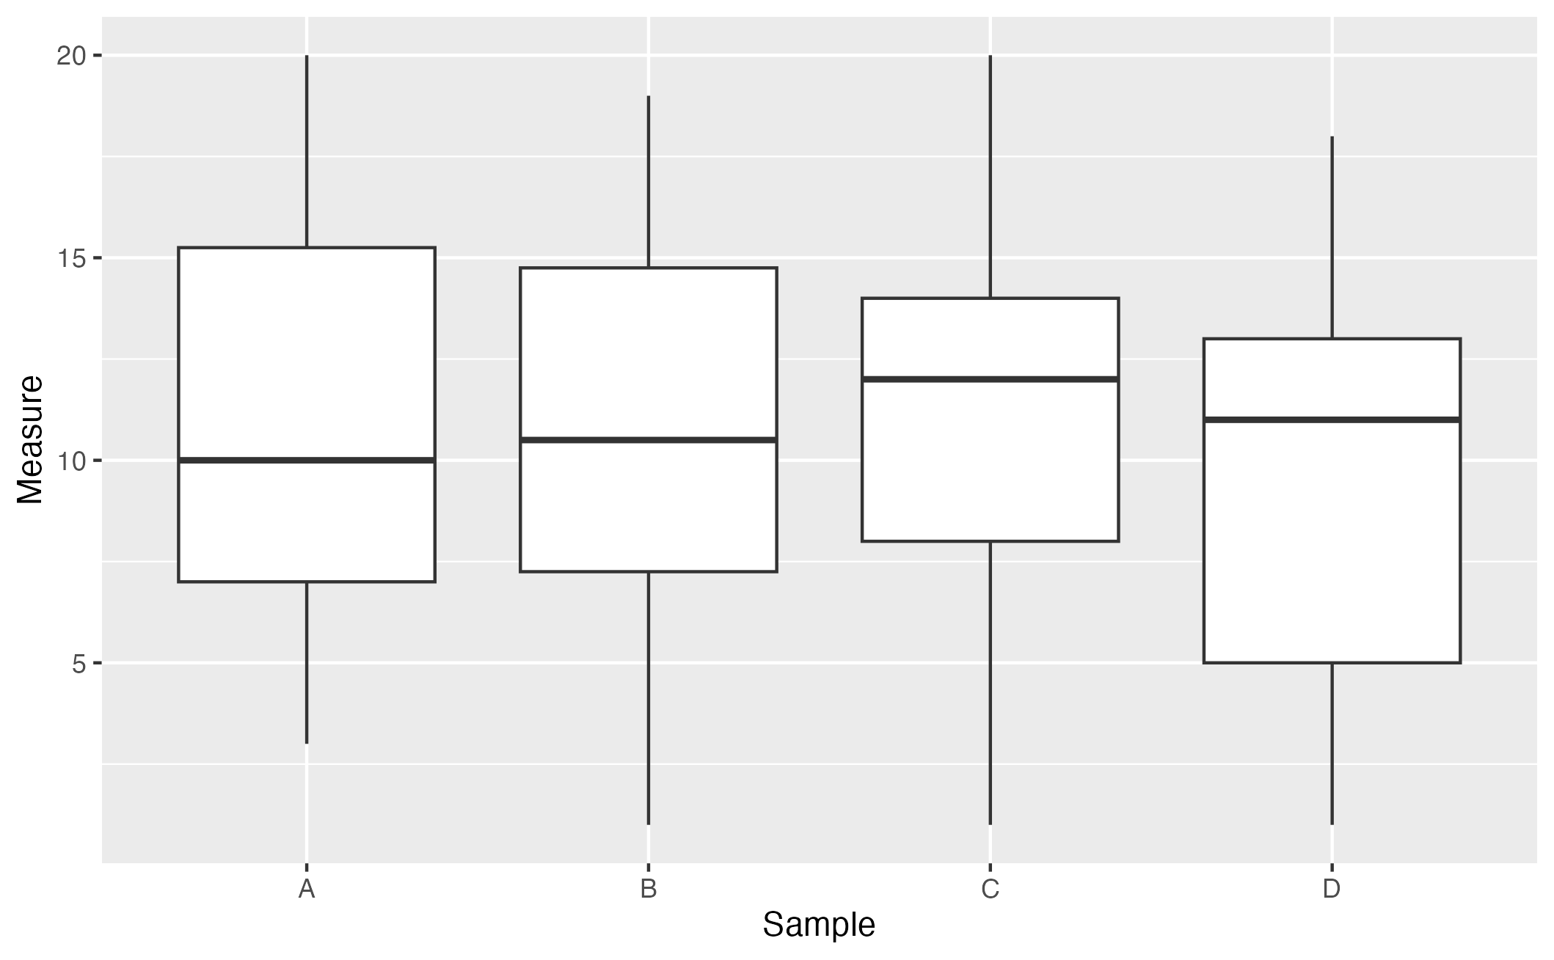
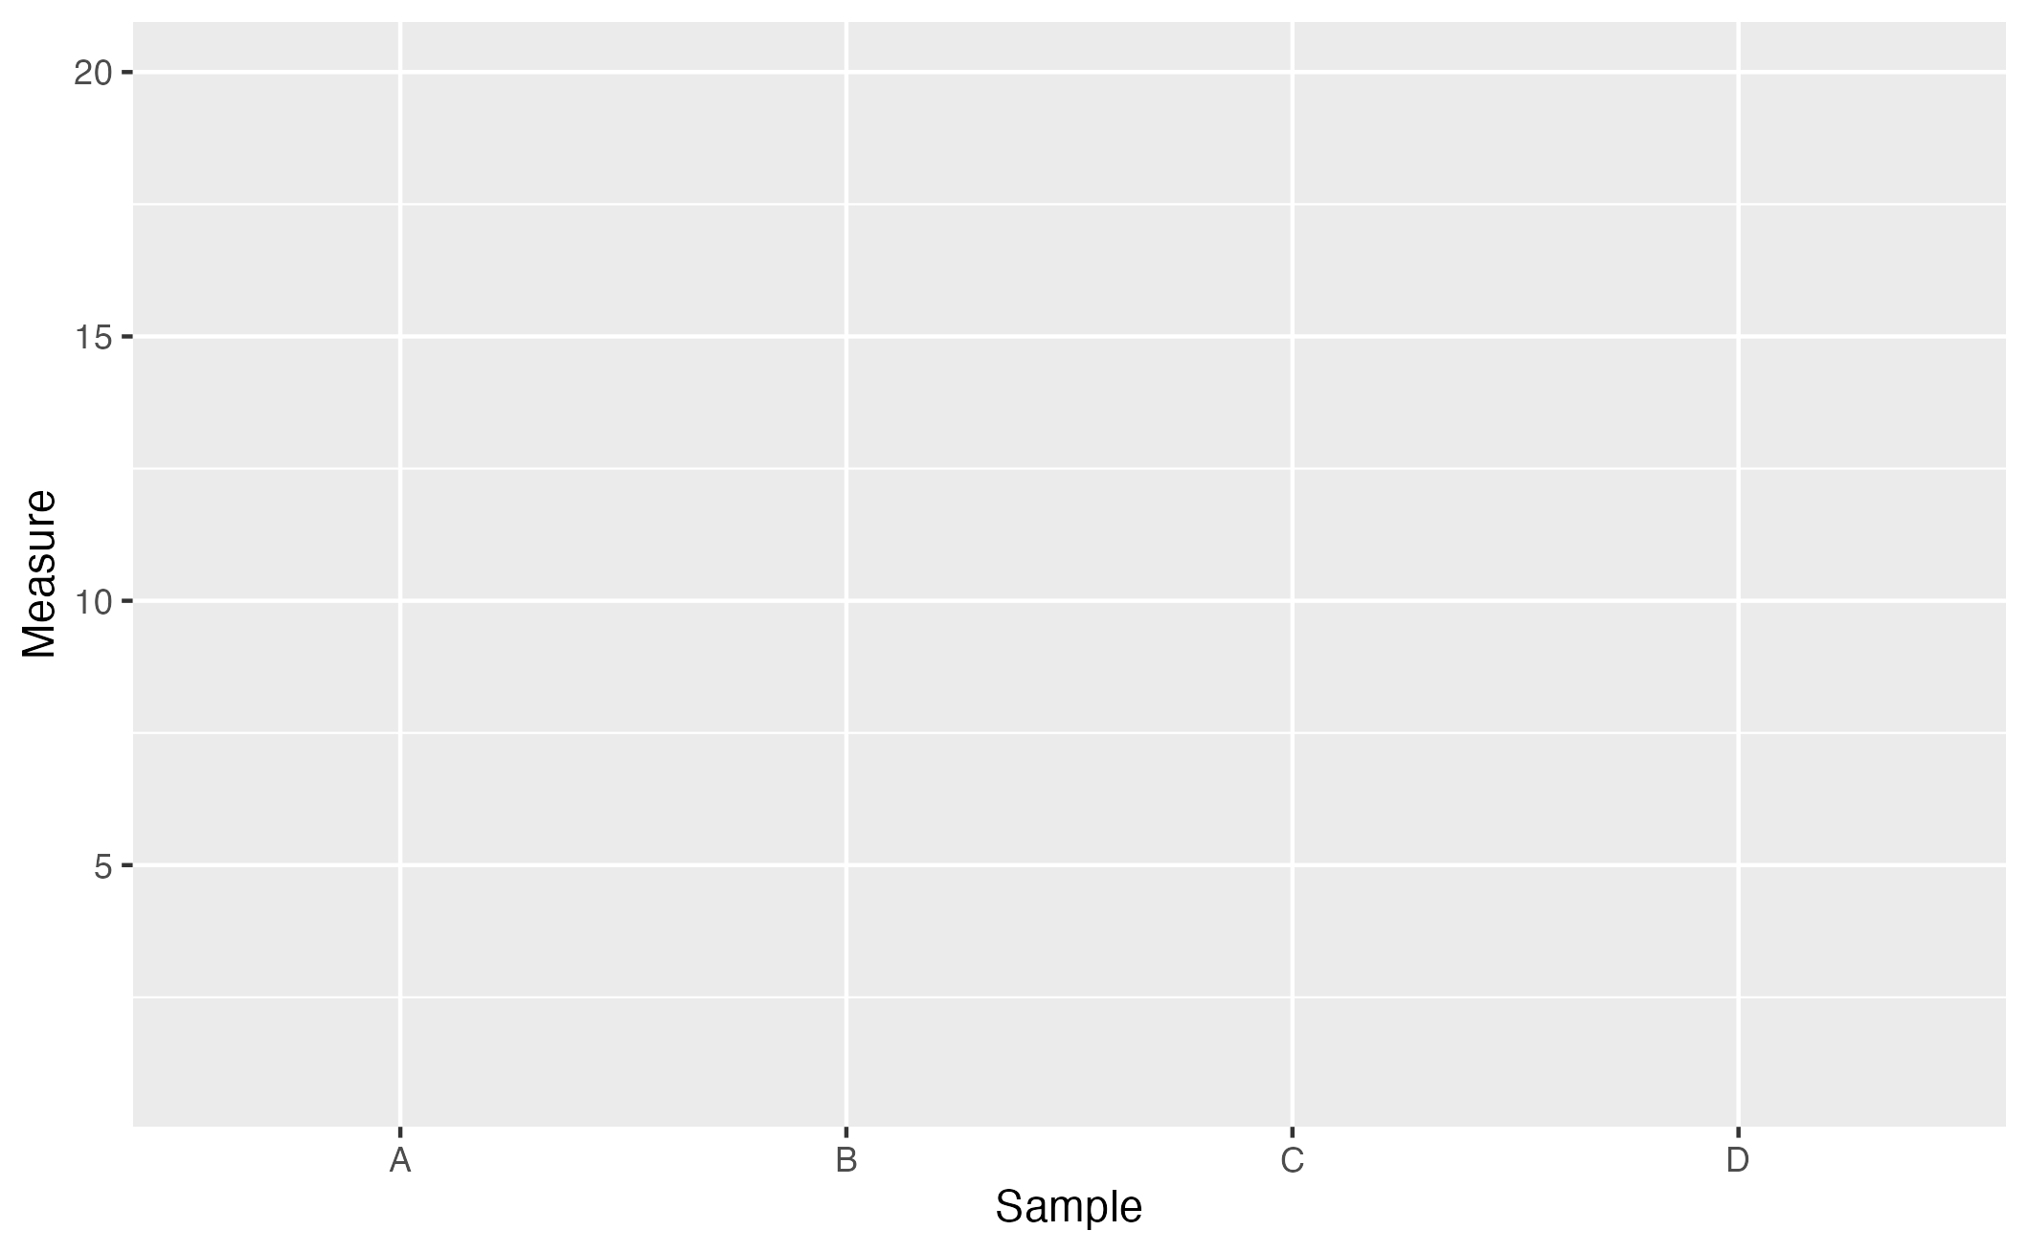
http://tutorials.iq.harvard.edu/R/Rgraphics/Rgraphics.html
DATASET, SAMPLES & OBSERVATIONS
ggplot(df,
aes(x = Sample, y = Measure))
GGPLOT2
ADDITIVE STRUCTURE
ggplot(df,
aes(x = Sample, y = Measure)) +
geom_boxplot()
DEFINE PLOT TYPE
23
Notes:
Aesthetic mappings describe how variables in the data are mapped to visual properties (aesthetics) of geoms.

Slide 25
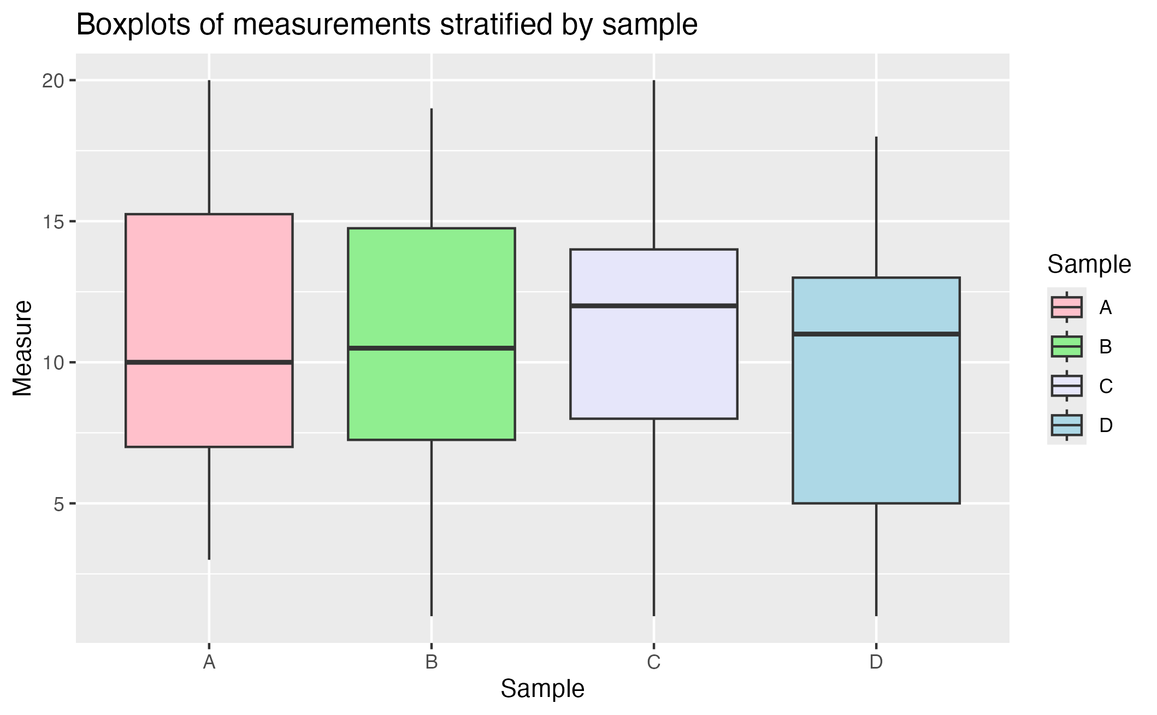
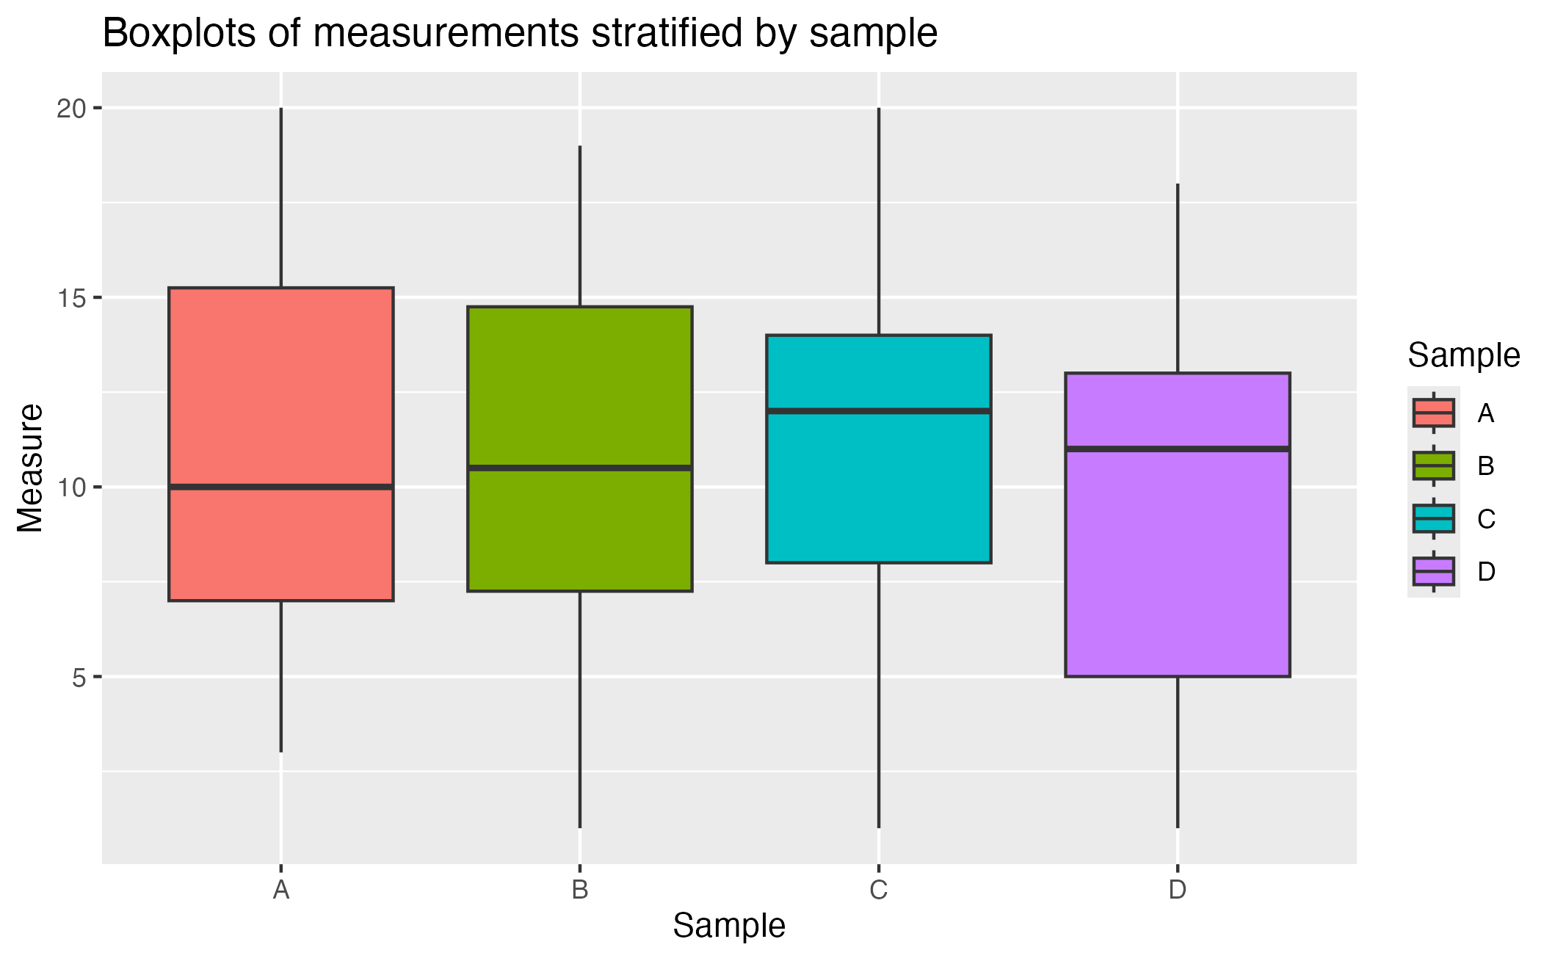
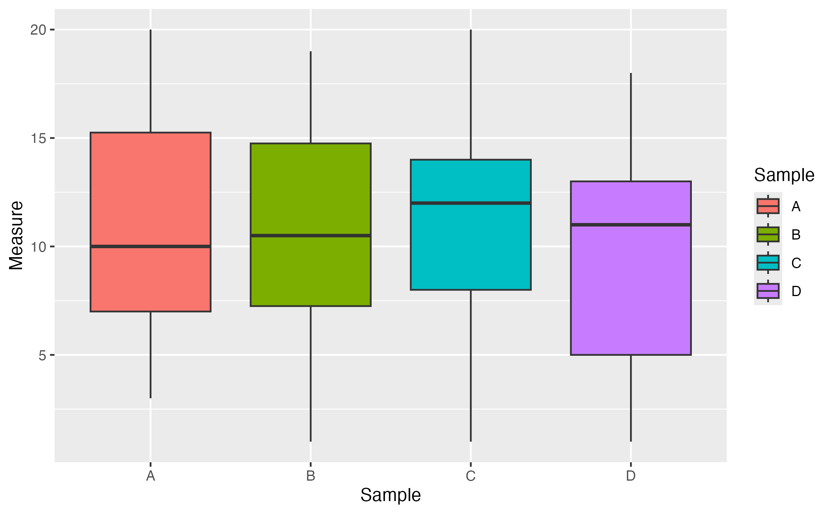
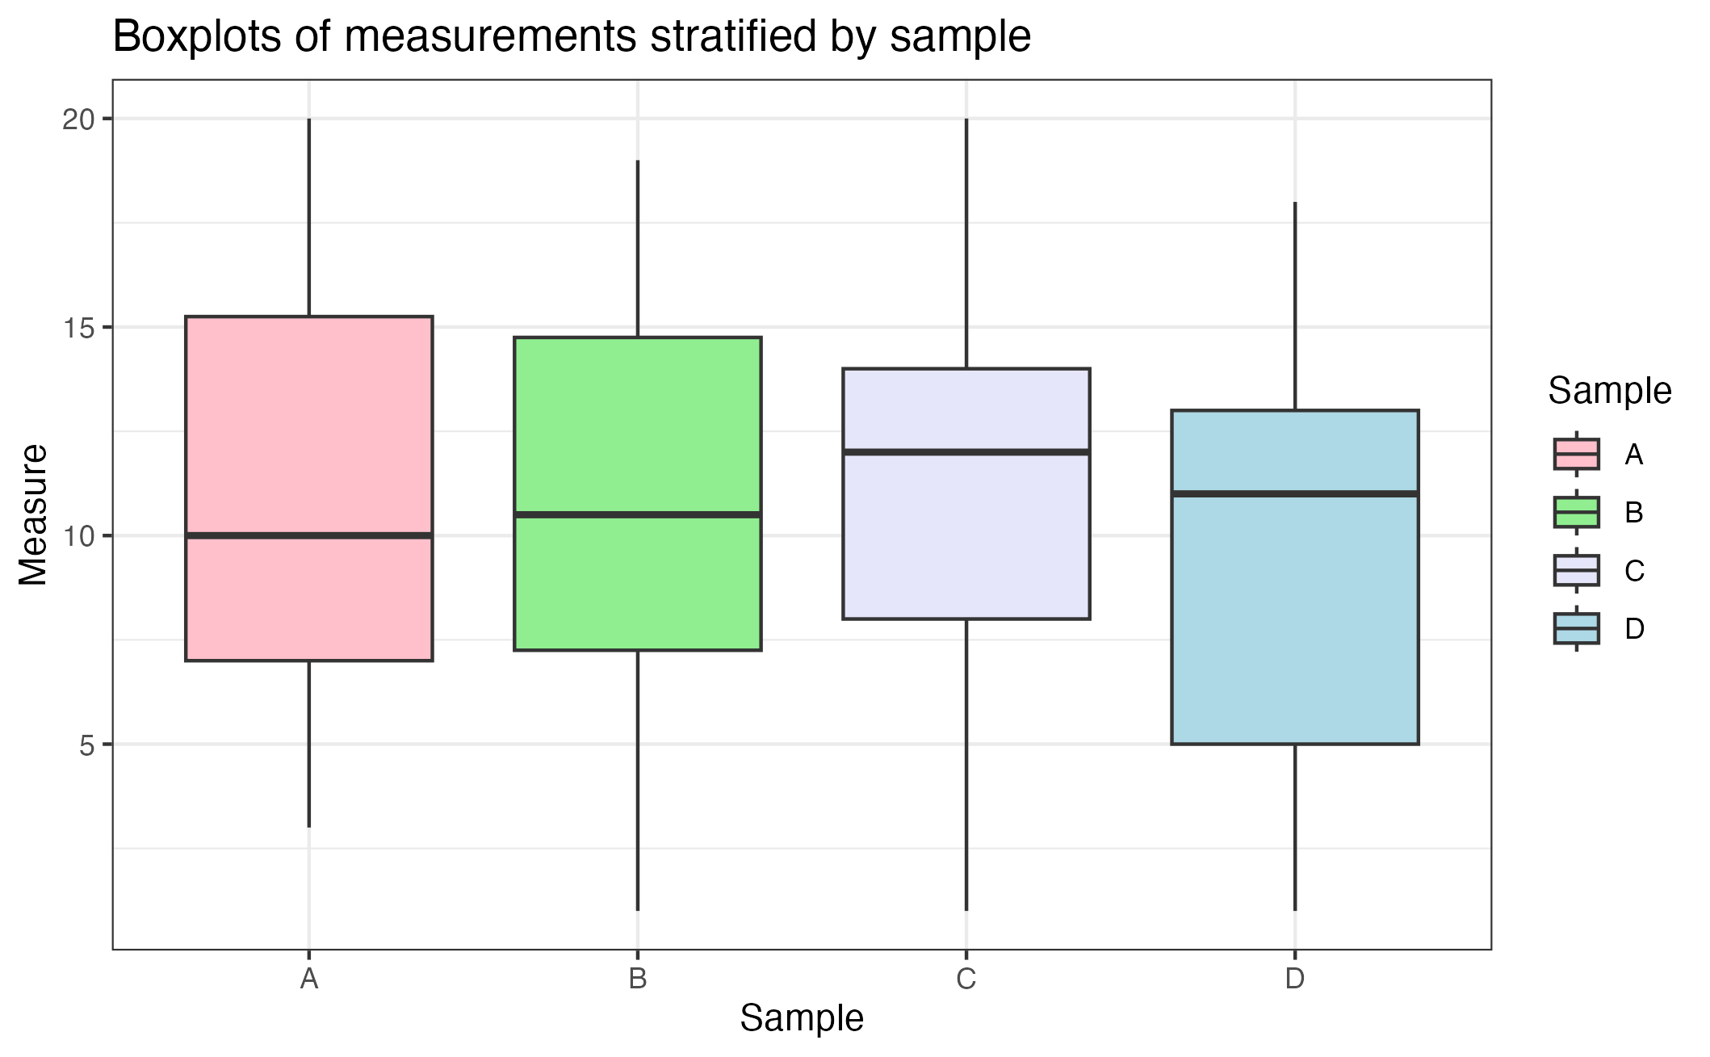
http://tutorials.iq.harvard.edu/R/Rgraphics/Rgraphics.html
DATASET, SAMPLES & OBSERVATIONS
ggplot(df,
aes(x = Sample, y = Measure))
GGPLOT2
ADDITIVE STRUCTURE
ggplot(df,
aes(x = Sample, y = Measure)) +
geom_boxplot()
DEFINE PLOT TYPE
ggplot(df,
aes(x = Sample, y = Measure,
fill = Sample)) +
geom_boxplot()
COLOR BY GROUP
TITLE AND LEGEND
… +
labs(title = ”Boxplots of measurements stratified by sample”)
… +
scale_fill_manual(values = c(”pink”, ”lightgreen”, ”lavender”, ”lightblue”))
CUSTOM COLORS
… +
theme_bw()
BACKGROUND
23
Notes:
Aesthetic mappings describe how variables in the data are mapped to visual properties (aesthetics) of geoms.

Slide 26
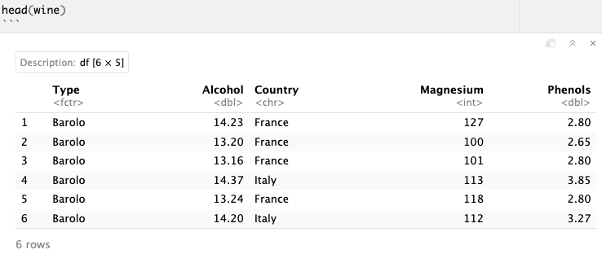
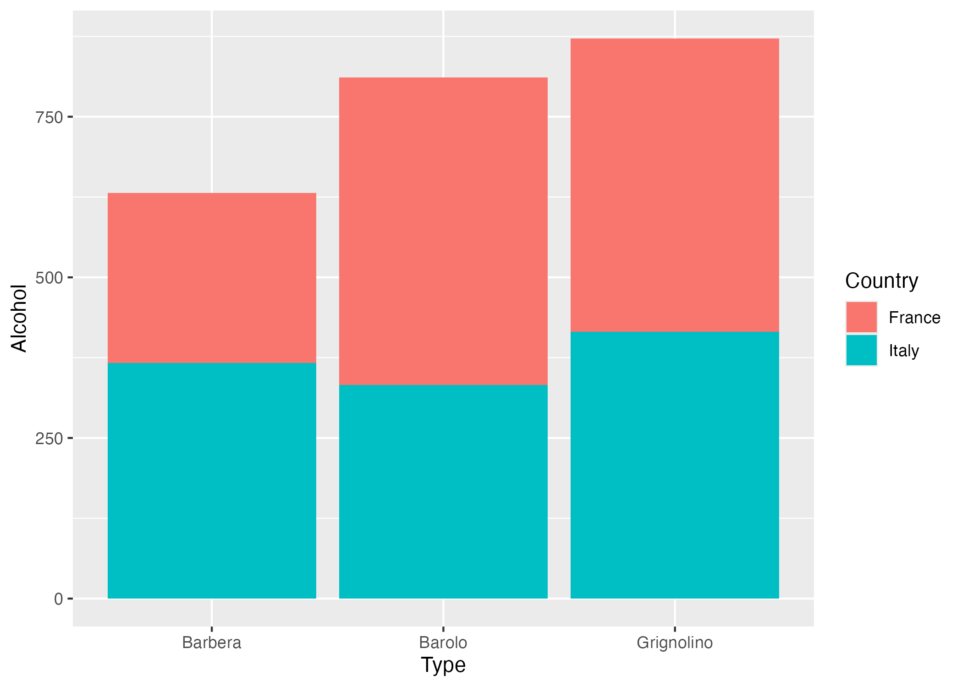
From Excel to R
GGPLOT BASIC STRUCTURE
Geoms inherit the parameters from the ggplot they are added to:
ggplot(wine,
aes(x = Type,
y = Alcohol,
fill = Country)) +
geom_col()
24

Slide 27
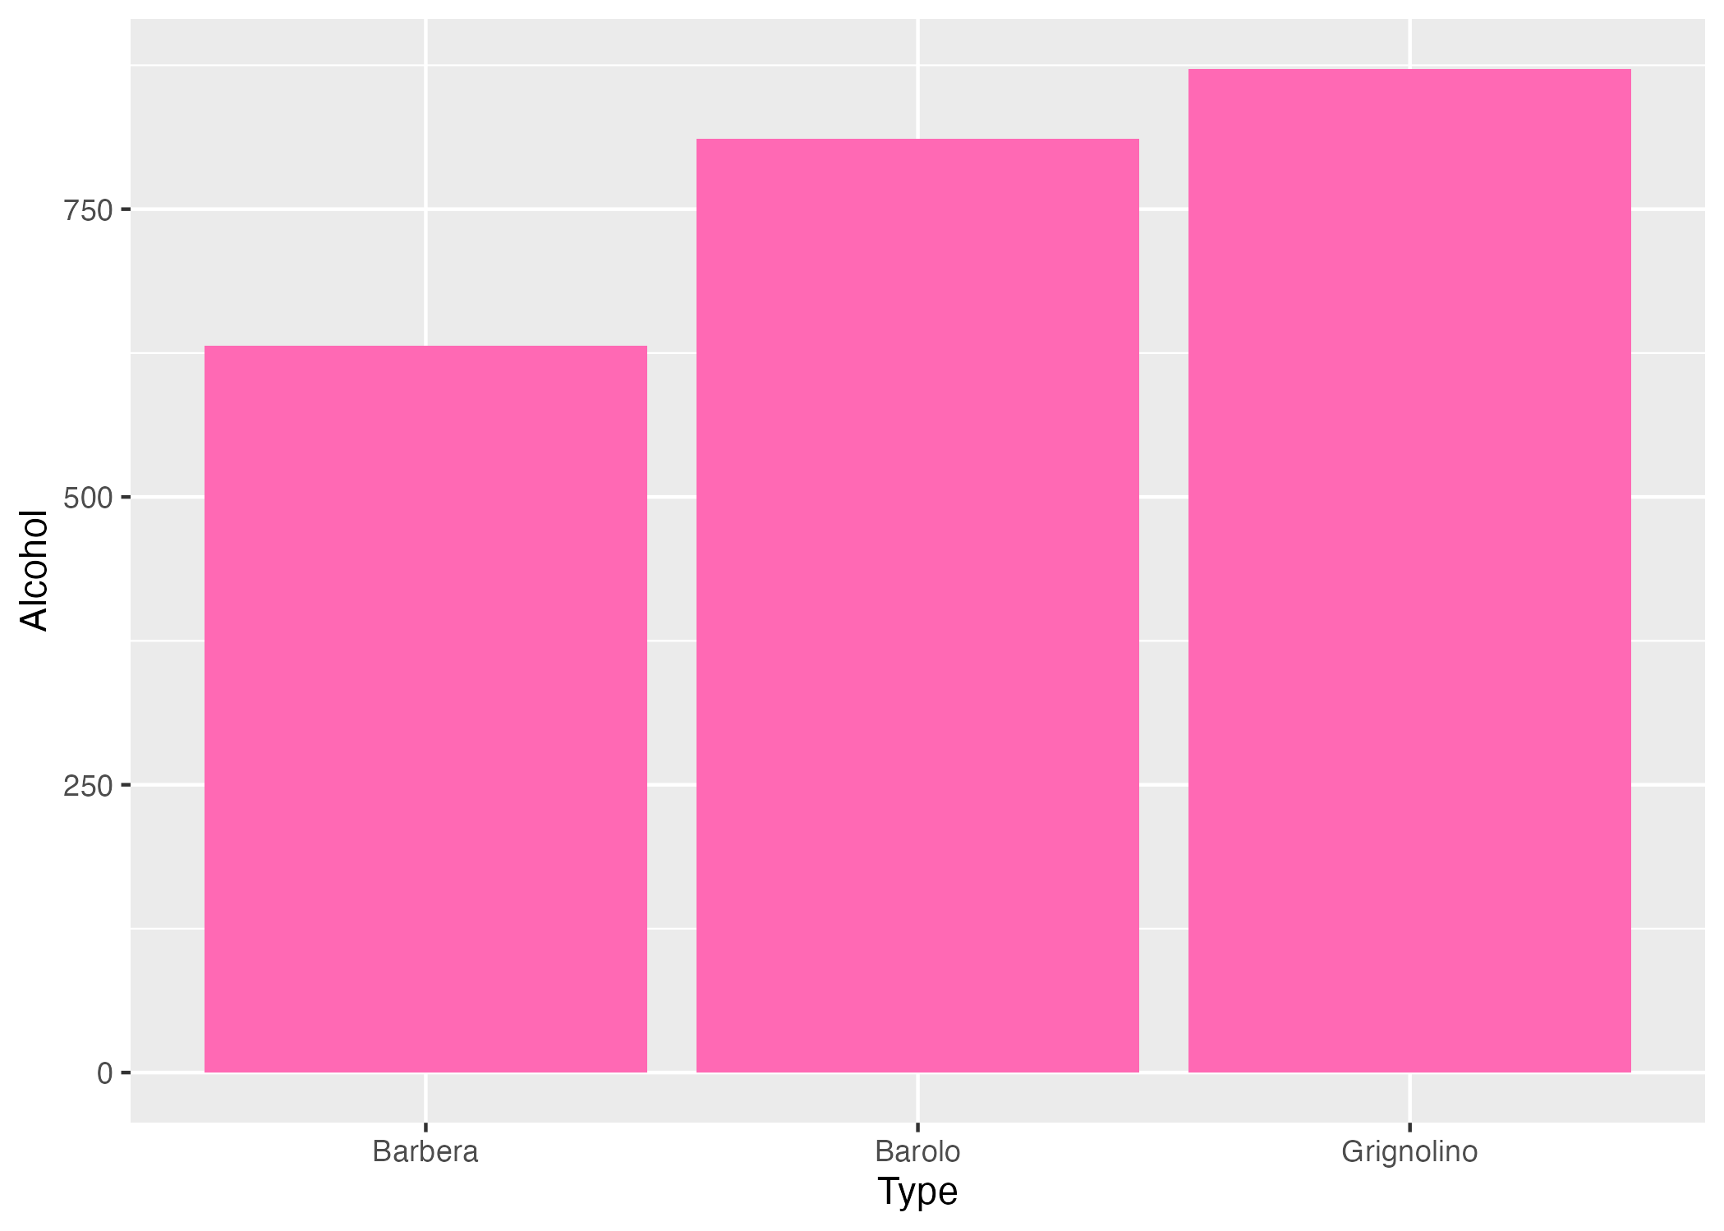
From Excel to R
GGPLOT BASIC STRUCTURE
Geoms inherit the parameters from the ggplot they are added to:
Alternatively, you can specify additional parameters directly in the geom:
Things outside the aes are applied to everything!
ggplot(wine,
aes(x = Type,
y = Alcohol,
fill = Country)) +
geom_col()
ggplot(wine,
aes(x = Type,
y = Alcohol)) +
geom_col(aes(fill = Country))
ggplot(wine,
aes(x = Type,
y = Alcohol)) +
geom_col(fill = ”hotpink”)
24

Slide 28

FROM EXCEL TO R
LIVE CODING 3 – GGPLOT 2

Slide 29
https://rstudio.com/wp-content/uploads/2016/11/ggplot2-cheatsheet-2.1.pdf
GGPLOT CHEAT SHEET
Define Plot:
Add Plot Type:
GET STARTED
ggplot(data = my.data,
aes(x = x.var,
y = y.var))
… + geom_point() # scatter plot
… + geom_line()
… + geom_boxplot()
… + geom_col()
… + geom_density()
… + geom_histogram()
One Color:
Color Fill by Group:
Custom Colors:
ggplot(…, aes(…), color = "green")
ggplot(…, aes(…, fill = z.var))
… + scale_*_manual(values = c())
ex: scale_color_manual(values = c("blue", "pink"))
COLORS
More Colors:
Labels:
… + labs(title = ”Title”,
x = ”X label”,
y = ”Y label”)
COLOR SCALES & THEMES
… + scale_fill_grey(start = 0.2, end = 0.8)
… + scale_fill_gradient(low="white", high="red")
Theme:
… + theme_bw()
… + theme_minimal()
… + theme_dark()
… + theme_classic()
Text:
… + theme(legend.position = *)
* = ”none”, ”top”, ”bottom”, ”left”, ”rigth”
TEXT
25

Slide 30
1
2
GGPLOT2
R
Studio
3
EXERCISE 3
4
ggplot2
Bar plot
Scatter plot
Boxplot
…
Syntax
Aesthetics
5
27

Slide 31
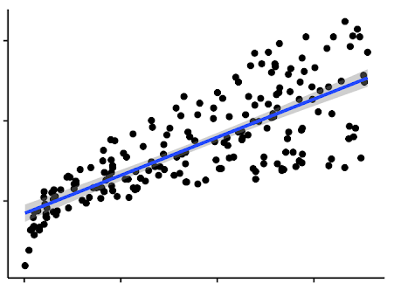
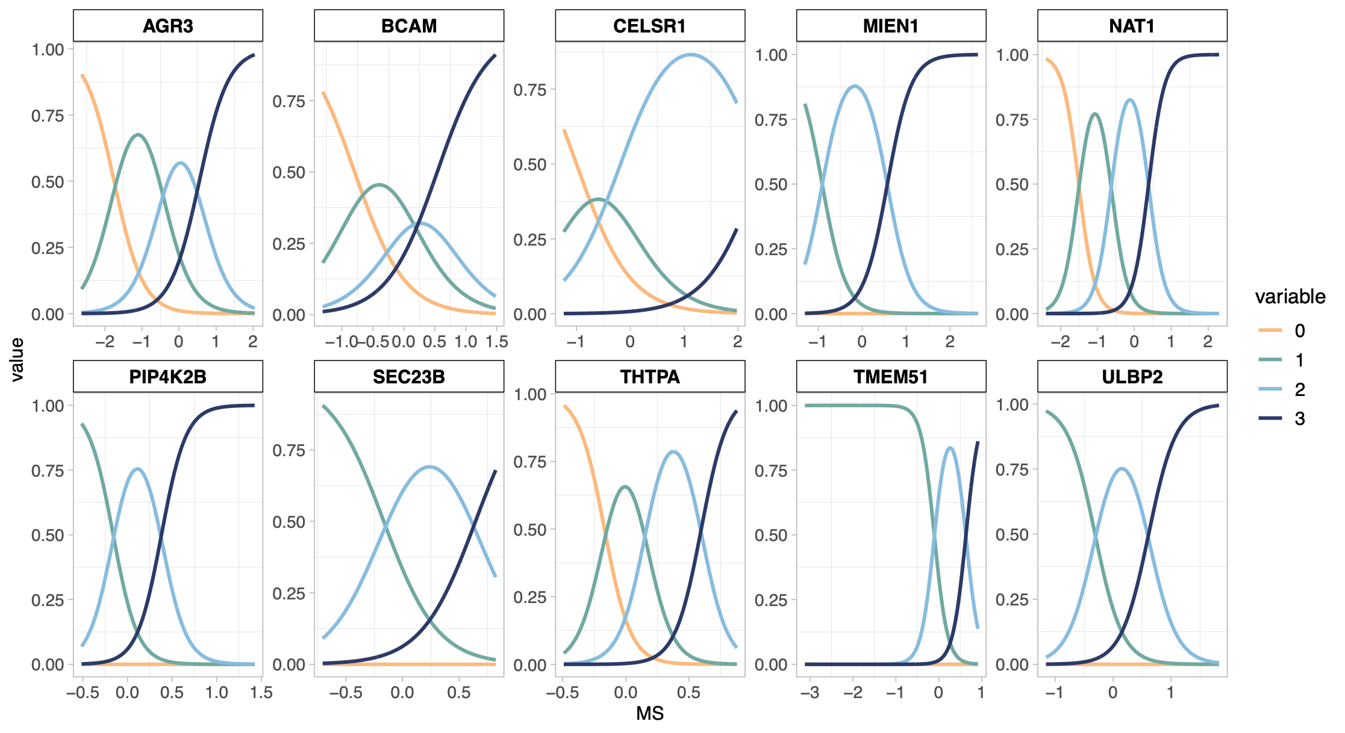
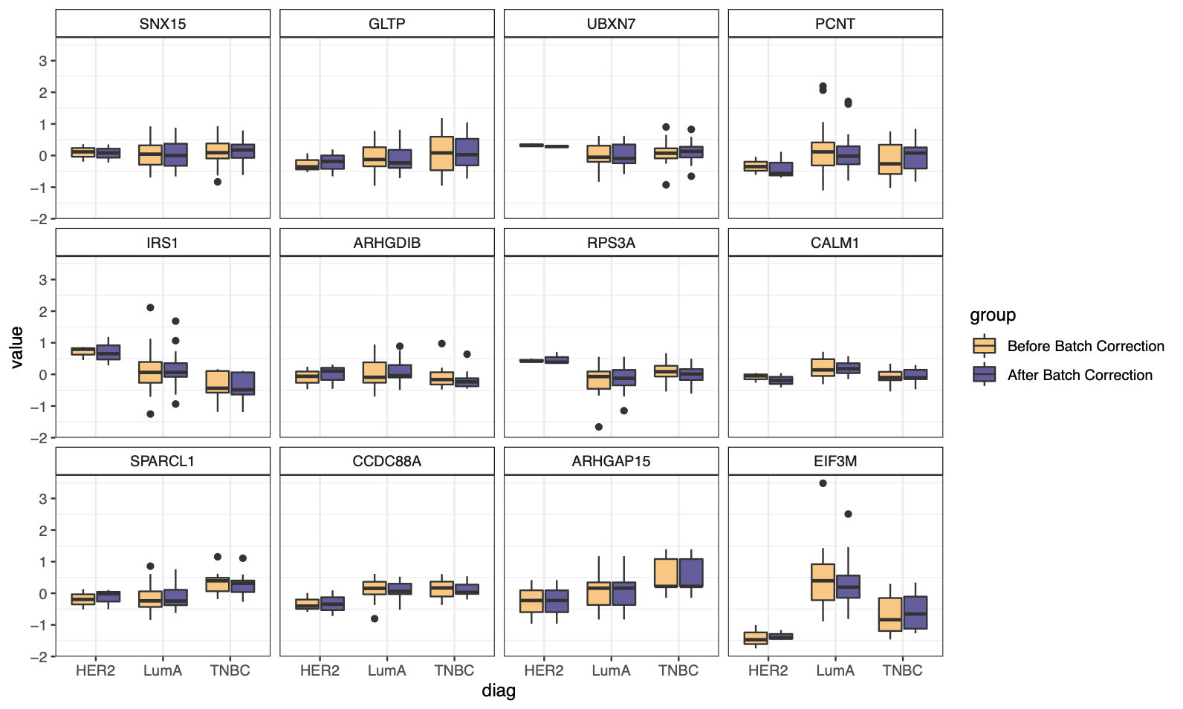
http://www.sthda.com/english/
R - A STATISTICAL
SCRIPTING LANGUAGE
Y
MODEL FUNCTIONS
EMMEANS PACKAGE
lm(), glm()
lmer(), glmer(),
nls(), …
emmeans(), pairs(), cld()
X
Variable 1
Variable 2
A
B
APPLY TO MODEL
MORE FUNCTIONS
summary(), anova(), confint(), predict(), drop1(), update(), step(), …
t.test(), cor(), cor.test(), aov(), quantile(), p.adjust(),
rank(), …
C
D
28

Slide 32

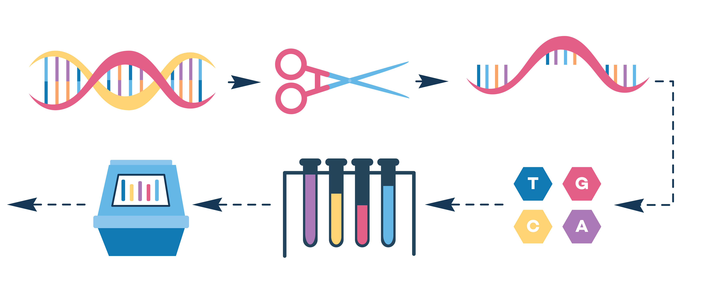

YOU
The researcher with R skills!
YOUR DATA
Gene expression data, i.e. how much a gene is used to produce a protein. Multiple genes measured in one experiment.
Let’s use R in a statistical analysis
YOUR DISEASE OF INTEREST
Psoriasis, an immune-mediated skin disorder.
29

Slide 33
http://www.sthda.com/english/
R - A STATISTICAL
SCRIPTING LANGUAGE
Y
During this session:
Cooperatively discuss and share ideas about the data
Apply steps of basic statistical analysis for hypothesis testing consistent with the given data
Suggest conclusions based on your analysis, regarding the association between psoriasis and gene expression levels
X
Variable 1
Variable 2
A
B
C
D
30

Slide 34

FROM EXCEL TO R
LIVE CODING 4 – APPLIED STATS

Slide 35
https://rstudio.com/resources/cheatsheets/ for various relevant cheat sheets.
Other example: https://www.dummies.com/programming/r/statistical-analysis-with-r-for-dummies-cheat-sheet/
STATS CHEAT SHEET
Import Data:
Overview of Data:
GET STARTED
read_excel(“my.data.xlsx”)
summary(my.data)
nrow(my.data)
length(my.data)
names(my.data)
Linear:
Logistic:
Linear Mixed:
Check Model:
summary(model) par(mfrow=c(2,2))
plot(model)
REGRESSION MODELS
lm(y~x, data=my.data)
confint(model)
glm(y~x,
data=my.data)
lmer(y~x + (1|z), data=my.data)
ANOVA:
F-Test:
Emmeans:
TESTS/COMPARISONS
anova(model2, model1)
drop1(model, test="F")
emmeans(model,~x)
pairs(emmeans(model,~x))
Check Type:
Change Type:
table(my.data$x)
is.numeric(my.data$x)
is.factor(my.data$x)
my.data <- mutate(my.data, x = factor(x))
my.data$z <- as.numeric(my.data$z)
VARIABLES
31

Slide 36
1
2
R
Studio
3
Statistics in R
EXERCISE 4
4
5
Linear regression
Summary Statistics
ANOVA
Logistic regression
Clustering
Correlation
32

Slide 37

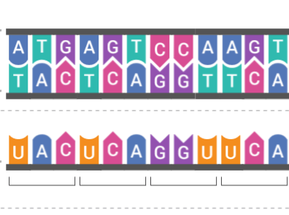
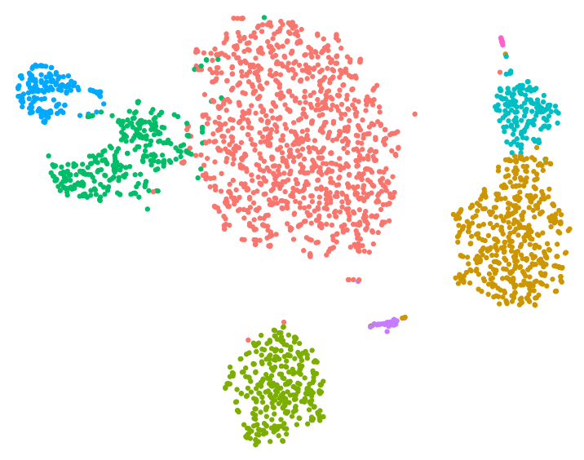
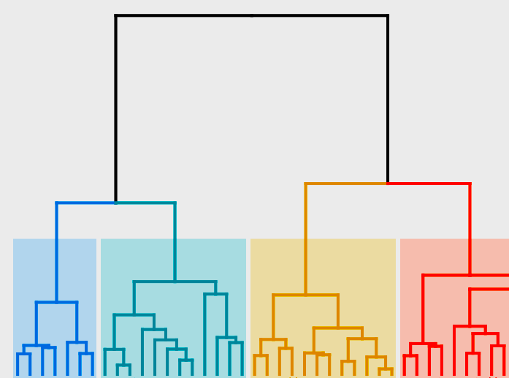
https://www.r-graph-gallery.com/
BIOINFORMATICS IN R
HIGH THROUGHPUT DATA
BIOINFORMATIC ANALYSIS
DIMENSIONALITY REDUCTION
CLUSTERING
DNA
RNA
PROTEIN
MACHINE LEARNING
NETWORK ANALYSIS
RNA SEQ DATA
PROTEOMICS DATA
33

Slide 38
1
2
R
Studio
3
Statistics in R
EXERCISE 5
4
5
Tidyverse
ggplot
Stats
Quarto
34

Slide 39
FROM EXCEL TO R
THE TOP OF THE R ICEBERG
STATISTICAL ANALYSIS
DATA MANGEMENT
Statistical models (linear, generalized, mixed, …)
EASY PLOTTING
Statistical tests (t-test, chisq, anova, …)
Survival analysis (Cox, Kaplan meier)
BIOINFORMATIC ANALYSIS
R
35

Slide 40
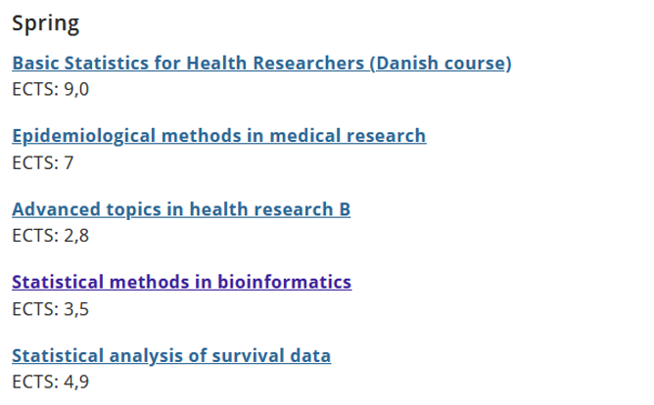
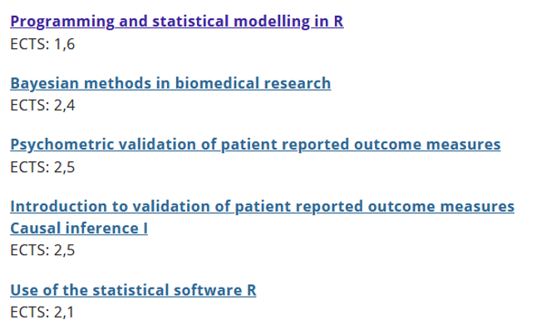
FROM EXCEL TO R
WANT MO-R-E?
The Section for Biostatistics offers a number statistics-oriented R courses:
https://publichealth.ku.dk/about-the-department/biostat/
* These are screenshots. Go to the website and scroll down to ‘Teaching’
36

Slide 41
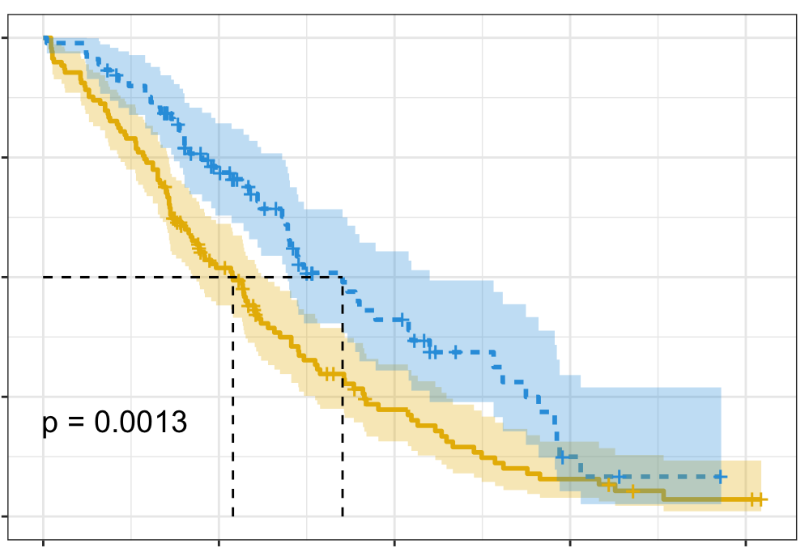
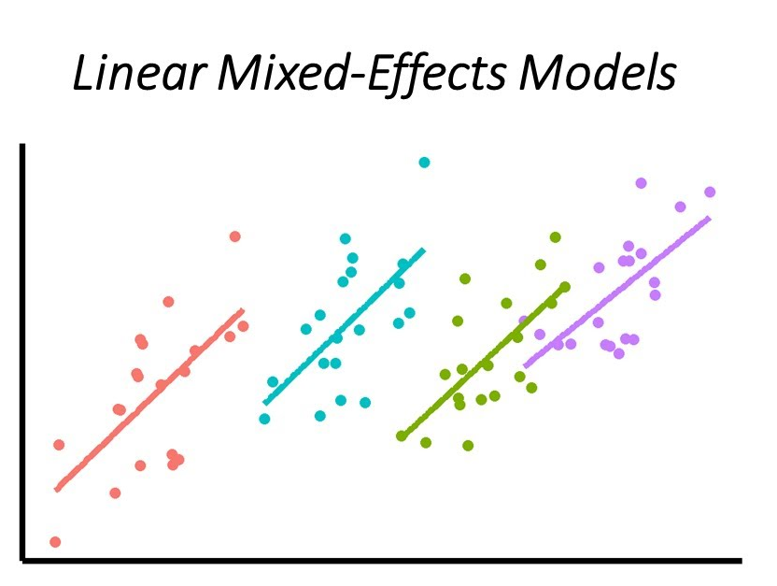
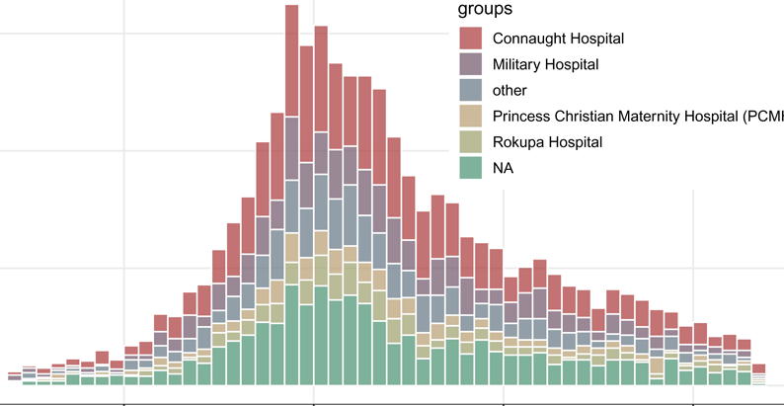
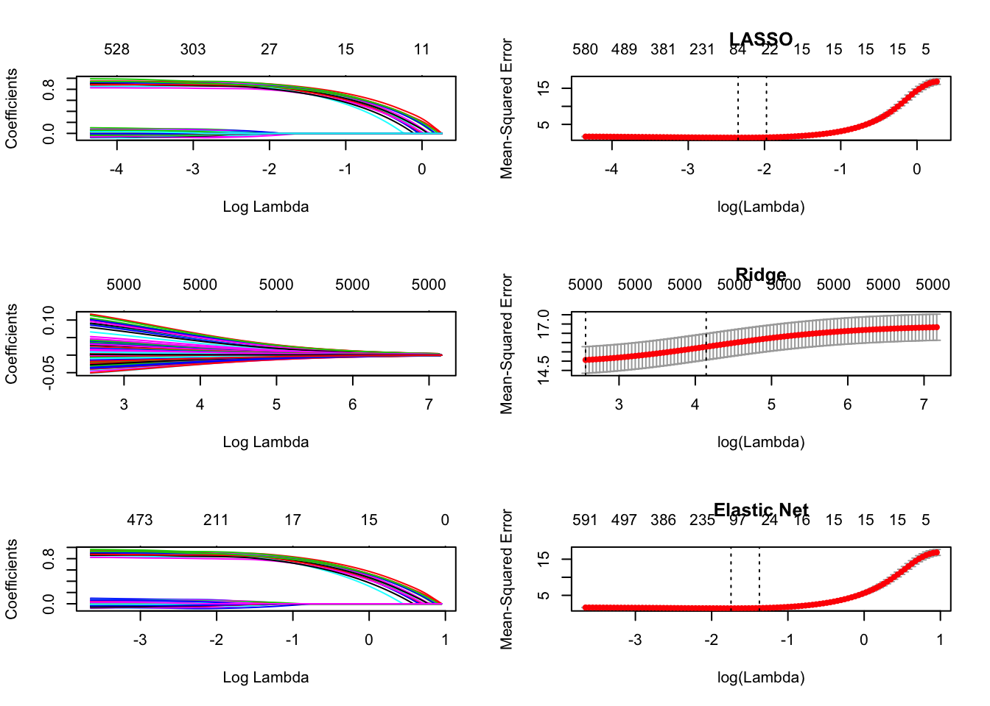
Survival Analysis
survival: https://rviews.rstudio.com/2017/09/25/survival-analysis-with-r/
survminer: https://cran.r-project.org/web/packages/survminer/survminer.pdf
(https://rpkgs.datanovia.com/survminer/ )
Mixed-Effects Models
lme4: https://cran.r-project.org/web/packages/lme4/vignettes/lmer.pdf
https://cran.microsoft.com/snapshot/2017-08-01/web/packages/sjPlot/vignettes/sjplmer.html
glmmTMB: https://cran.r-project.org/web/packages/glmmTMB/index.html
TEASER
STATISTICS in R
Epidemiological Analysis
Epi: https://cran.r-project.org/web/packages/Epi/index.html
pubh: https://rviews.rstudio.com/2020/03/05/covid-19-epidemiology-with-r/
https://cran.r-project.org/web/packages/incidence/vignettes/customize_plot.html
https://rviews.rstudio.com/2020/03/05/covid-19-epidemiology-with-r/
Elastic-Net Regression (R
glmnet: https://cran.r-project.org/web/packages/glmnet/glmnet.pdf
elasticnet: https://cran.r-project.org/web/packages/elasticnet/elasticnet.pdf
https://www.datacamp.com/community/tutorials/tutorial-ridge-lasso-elastic-net
21
37

Slide 42


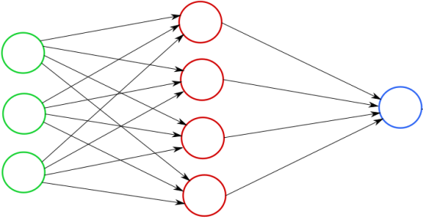
Clustering
Feature Selection: PCA
Missing Data
TEASER
Machine Learning
https://lgatto.github.io/IntroMachineLearningWithR/an-introduction-to-machine-learning-with-r.html
https://statsandr.com/blog/clustering-analysis-k-means-and-hierarchical-clustering-by-hand-and-in-r/
https://bioconductor.org/packages/release/bioc/vignettes/PCAtools/inst/doc/PCAtools.html
https://amices.org/mice/
https://datascienceplus.com/imputing-missing-data-with-r-mice-package/
Random Forest
kNN
SVM
Neural Networks
https://www.blopig.com/blog/2017/04/a-very-basic-introduction-to-random-forests-using-r/
https://www.edureka.co/blog/knn-algorithm-in-r/
https://cran.r-project.org/web/packages/e1071/vignettes/svmdoc.pdf
https://keras.rstudio.com/
https://tensorflow.rstudio.com/
38

Slide 43
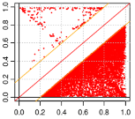
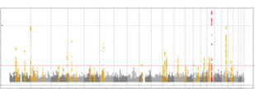
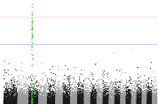
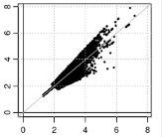





GWAS - QC &
Data Harmonization
GWAS Data Management & Plots
More Plotting…
EasyQC: https://www.uni-regensburg.de/medizin/epidemiologie-praeventivmedizin/genetische-epidemiologie/software/
EasyStrata: https://www.uni-regensburg.de/medizin/epidemiologie-praeventivmedizin/genetische-epidemiologie/software/
Manhattan and QQ plots: https://cran.r-project.org/web/packages/qqman/vignettes/qqman.htm l
TEASER
Omics Data
Gene Expression Analysis
Proteomics Analysis
Single-Cell RNASeq
http://www.bioconductor.org/packages/release/BiocViews.html
DESeq2, limma, EdgeR, etc.: http://www.bioconductor.org/packages/release/BiocViews.html#___RNASeq
RforProteomics: https://www.bioconductor.org/packages/release/BiocViews.html#___Proteomics
https://cran.r-project.org/web/packages/e1071/vignettes/svmdoc.pdf
39

Slide 44






PLOTTING IN 3D
DEEP LEARNING
BAYESIAN STATISTICS
FROM EXCEL TO R
https://plotly-r.com/d-charts.html
https://keras.rstudio.com/
https://tensorflow.rstudio.com/
https://mc-stan.org/users/interfaces/rstan
COOL STUFF IN R
WEBPAGE WITH R SHINY
INTERACTIVE PLOTS
MAIL AND MESSAGES
https://shiny.rstudio.com/
https://gganimate.com/articles/gganimate.html
https://github.com/briandconnelly/pushoverr
40

Slide 45


FROM EXCEL TO R
DATA SCIENCE WITH HEADS DATA LAB
Drop-in Thursday (13-15)
Consultations
Commission Research & Supervision
Events and Conferences
Course Reminders
REPRODUCIBLE ANALYSIS
Read more on HeaDS Website!
https://heads.ku.dk
Flow HeaDS on LinkedIn!
https://www.linkedin.com/company/ucph-heads/
41
Notes:
Always free to book a meeting with us to dicuss your project and how we can help.
Decide on a working model that works for the project.
PhD students gets 10 hrs of supervision for free.

Slide 46

THANK YOU FOR LISTENING
This presentation was created by Center for Health Data
Science, SUND, KU.
For internal use at KU only, do not distribute commercially.

